Slide 1

Global Food Security
and Global Security
Christopher B. Barrett
Cornell University
Presentation to
Madison Committee on Foreign Relations
October 12, 2022

Slide 2
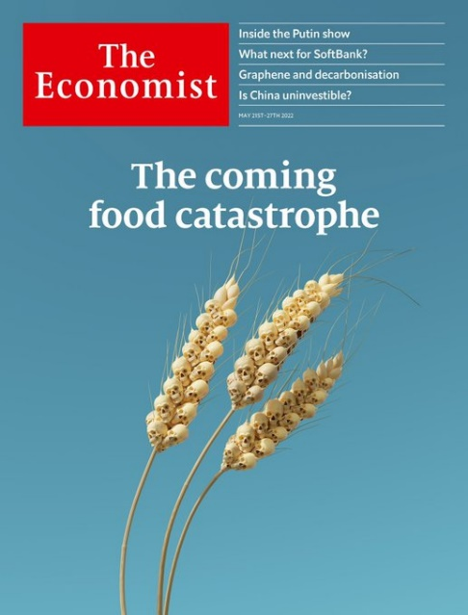
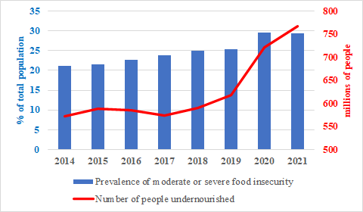
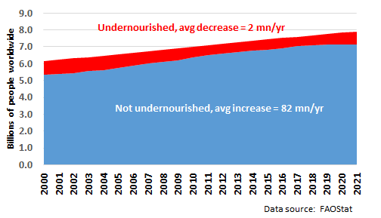
Is there a food security crisis?
“The World Is Headed for a Food Security Crisis”
– Time, Mar 2018
“A Global Food Crisis Looms” – New York Times, Apr 2020
Is there a food security crisis currently?
Yes …
… but more stalled progress than crisis

Slide 3
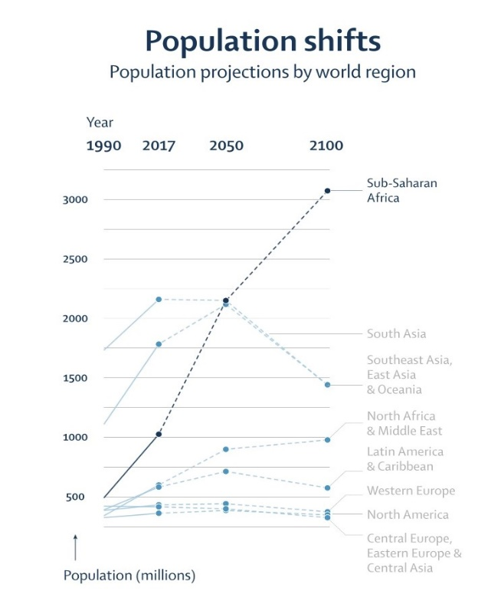
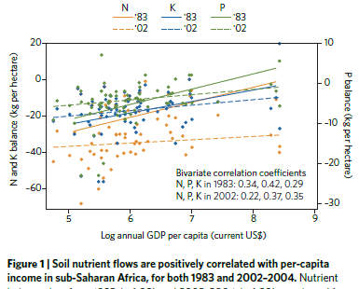
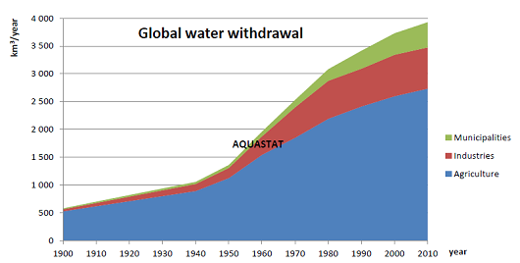
Formidable challenges …
These challenges are formidable
Long-run drivers:
1. Population/income growth, urbanization
robust demand growth
2. Land/water constraints + climate change + slowing productivity growth
headwinds for supply growth
Source: Barrett and Bevis Nature Geoscience 2015
Vollset et al. Lancet 2020

Slide 4
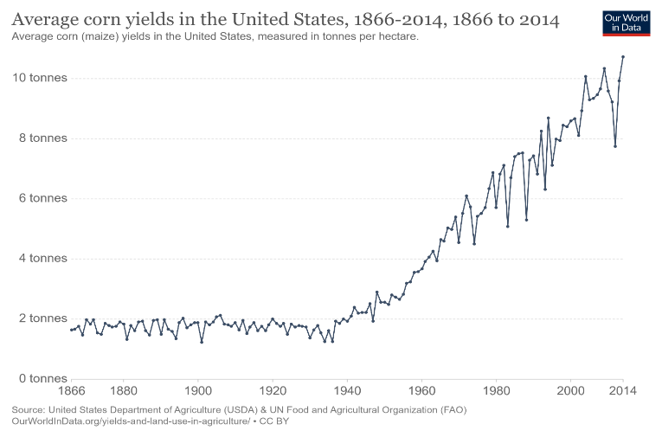
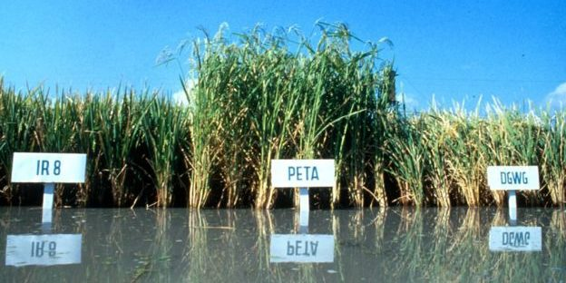
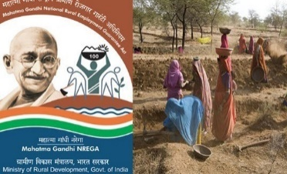

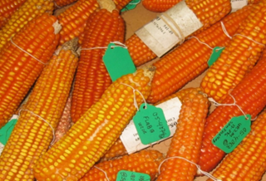
… but manageable
Formidable yes, but manageable
The world has previously overcome global food security challenges through scientific and social protection innovations.
Data: Our World in Data
Photo credits: IRRI, Forward Press, Edesia, Mike Gore
We can prevail again IFF we follow a progressive strategy:
trust in science + demonstrate solidarity w/poor … must bundle the two
Must define the task(s) correctly. It’s no longer hunger and yields.

Slide 5
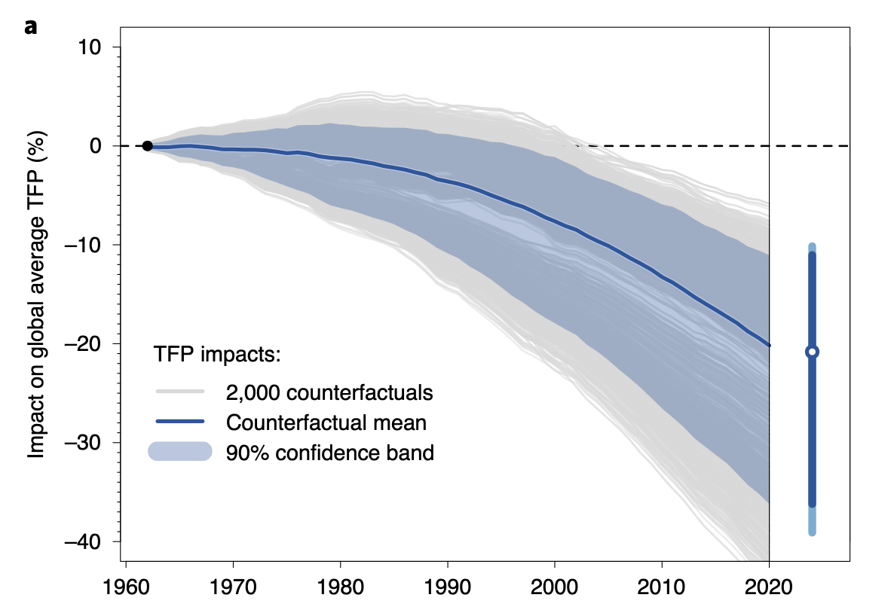
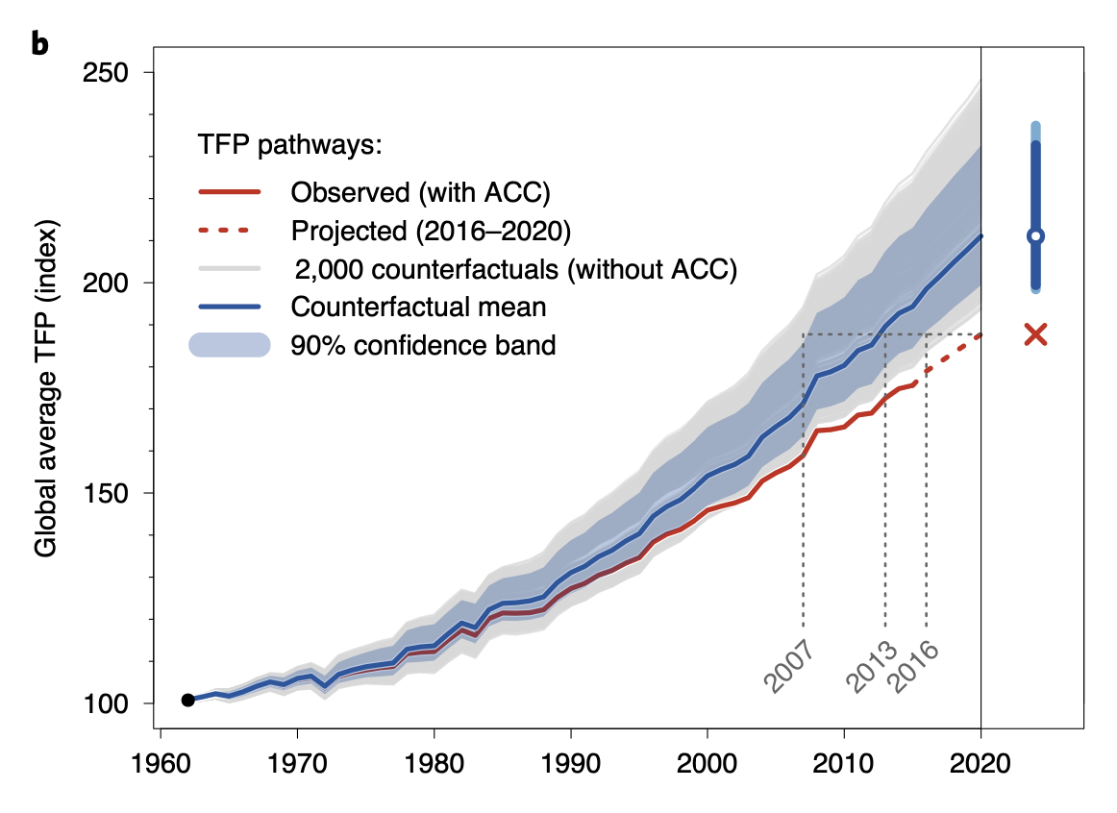
Four horsemen: C²M²
So what to tackle? The four horsemen of food crises
1. Climate change:
Fuel demand growth by forced displacement – climate refugees, droughts, etc.
Retards productivity advances and investment
Source: Ortiz-Bobea et al (Nature Climate Change, 2021)

Slide 6
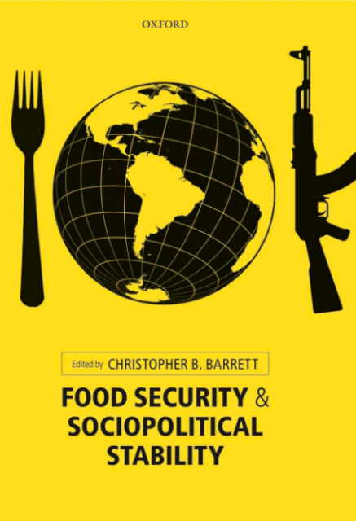
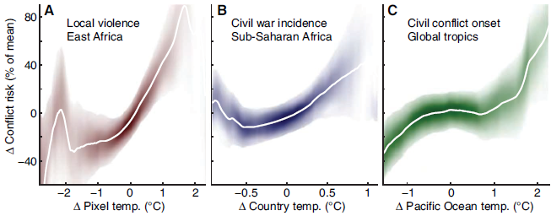
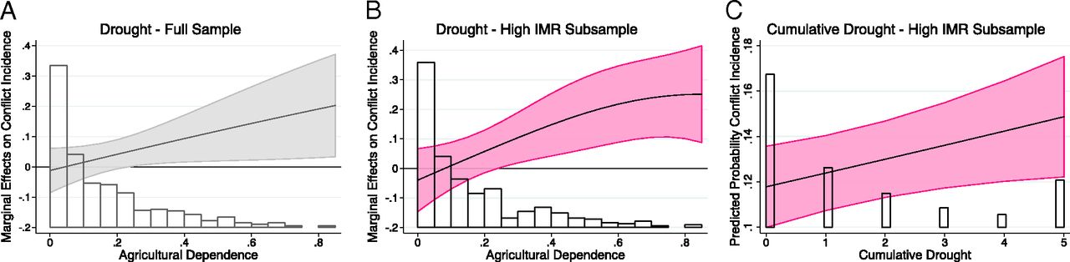
Four horsemen: C²M²
2. Conflict:
>89mn forcibly displaced +~15mn Ukraine this year… highest on record
Conflict-affected nations >75% of stunted children globally (FAO et al. 2017)
Pop. in fragile settings growing. >2bn now, ~ 80% world’s poor (OECD 2018)
Food insecurity destabilizes societies lacking strong social
safety nets. Unrest in ~50 nations 2007-12. Sri Lanka now.
And climate change makes it worse …
(Hsiang et al. 2013; von Uexkul et al. 2016)

Slide 7
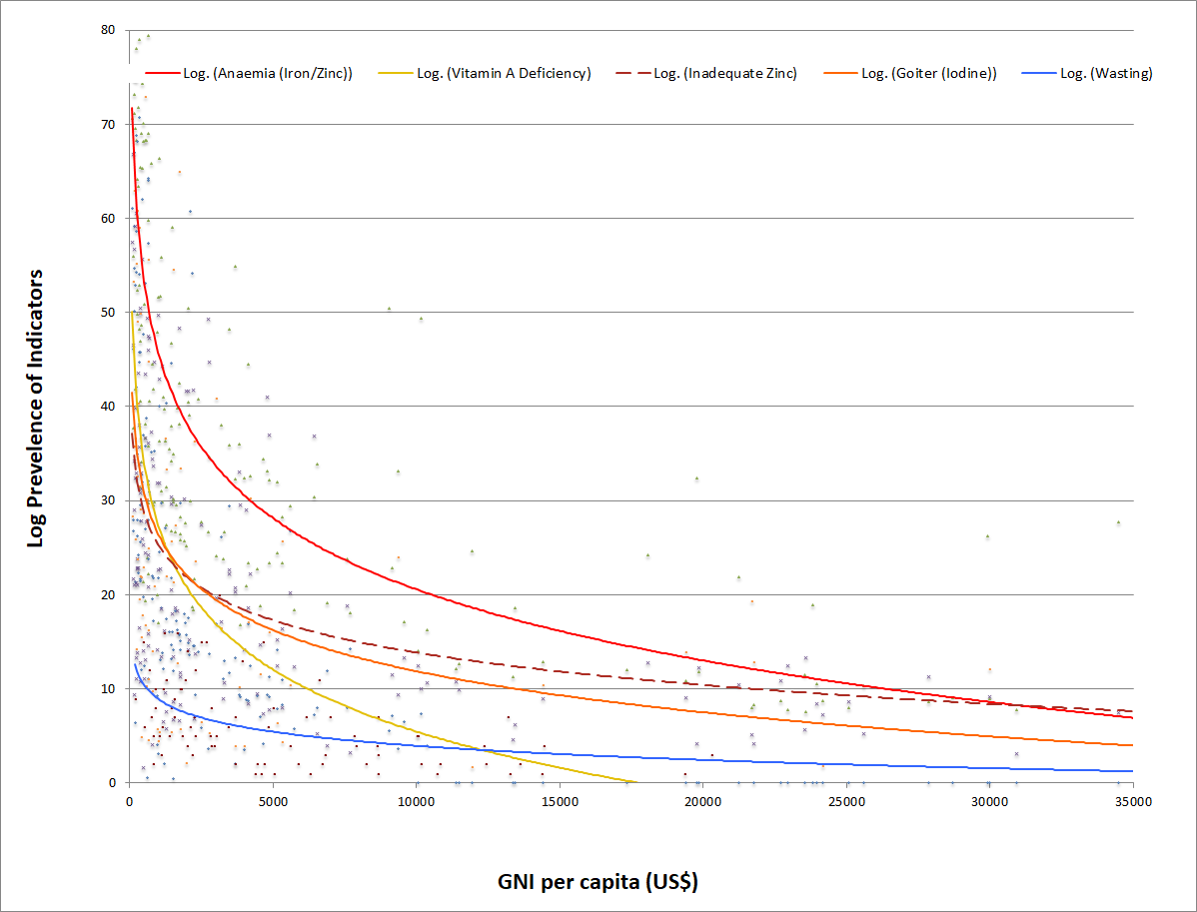
Four horsemen: C²M²
3. Macroeconomic growth and stability
Poverty is main cause of food insecurity. Growth reduces poverty.
>3 bn cannot afford a healthy diet.
COVID a massive setback, esp. in countries w/o strong safety nets
Macro slowdown/instability fuels flight to dollar,
aggravates debt and food price issues in LMICs
Source: Barrett and Bevis, 2015
Source: Barrett and Bevis, 2015

Slide 8
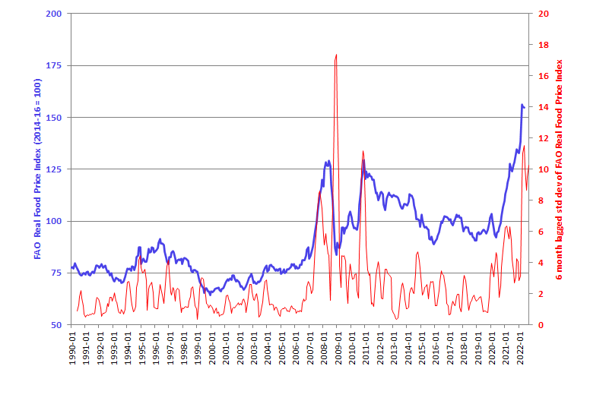
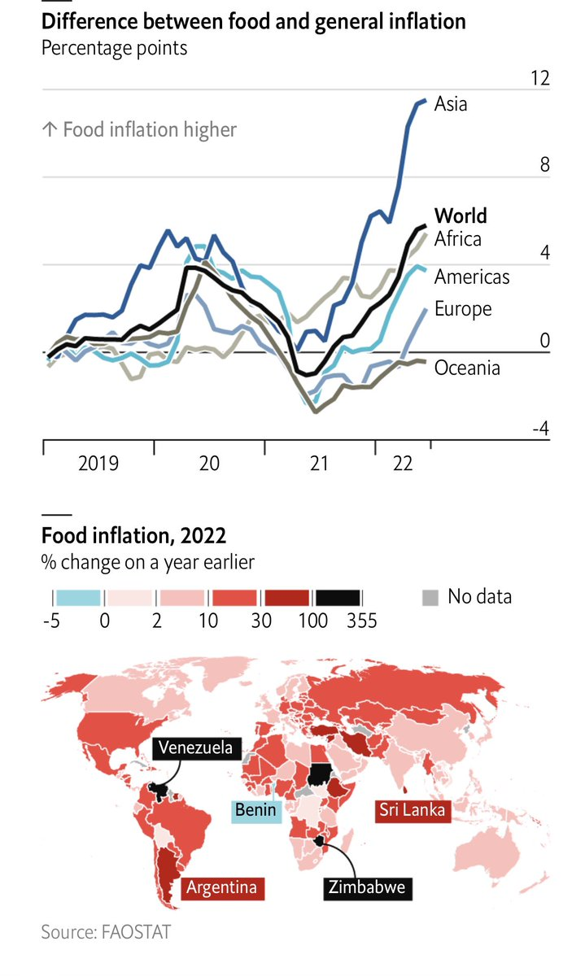

Four horsemen: C²M²
4. Market prices and volatility:
Double edged sword of globalization, esp. w/o effective WTO disciplines
Concentration within the agrifood value chains … excess profit-taking
If inflation outpaces income growth, hunger, poverty and insecurity grow.
Source: The Economist

Slide 9
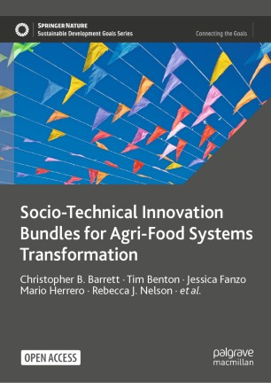
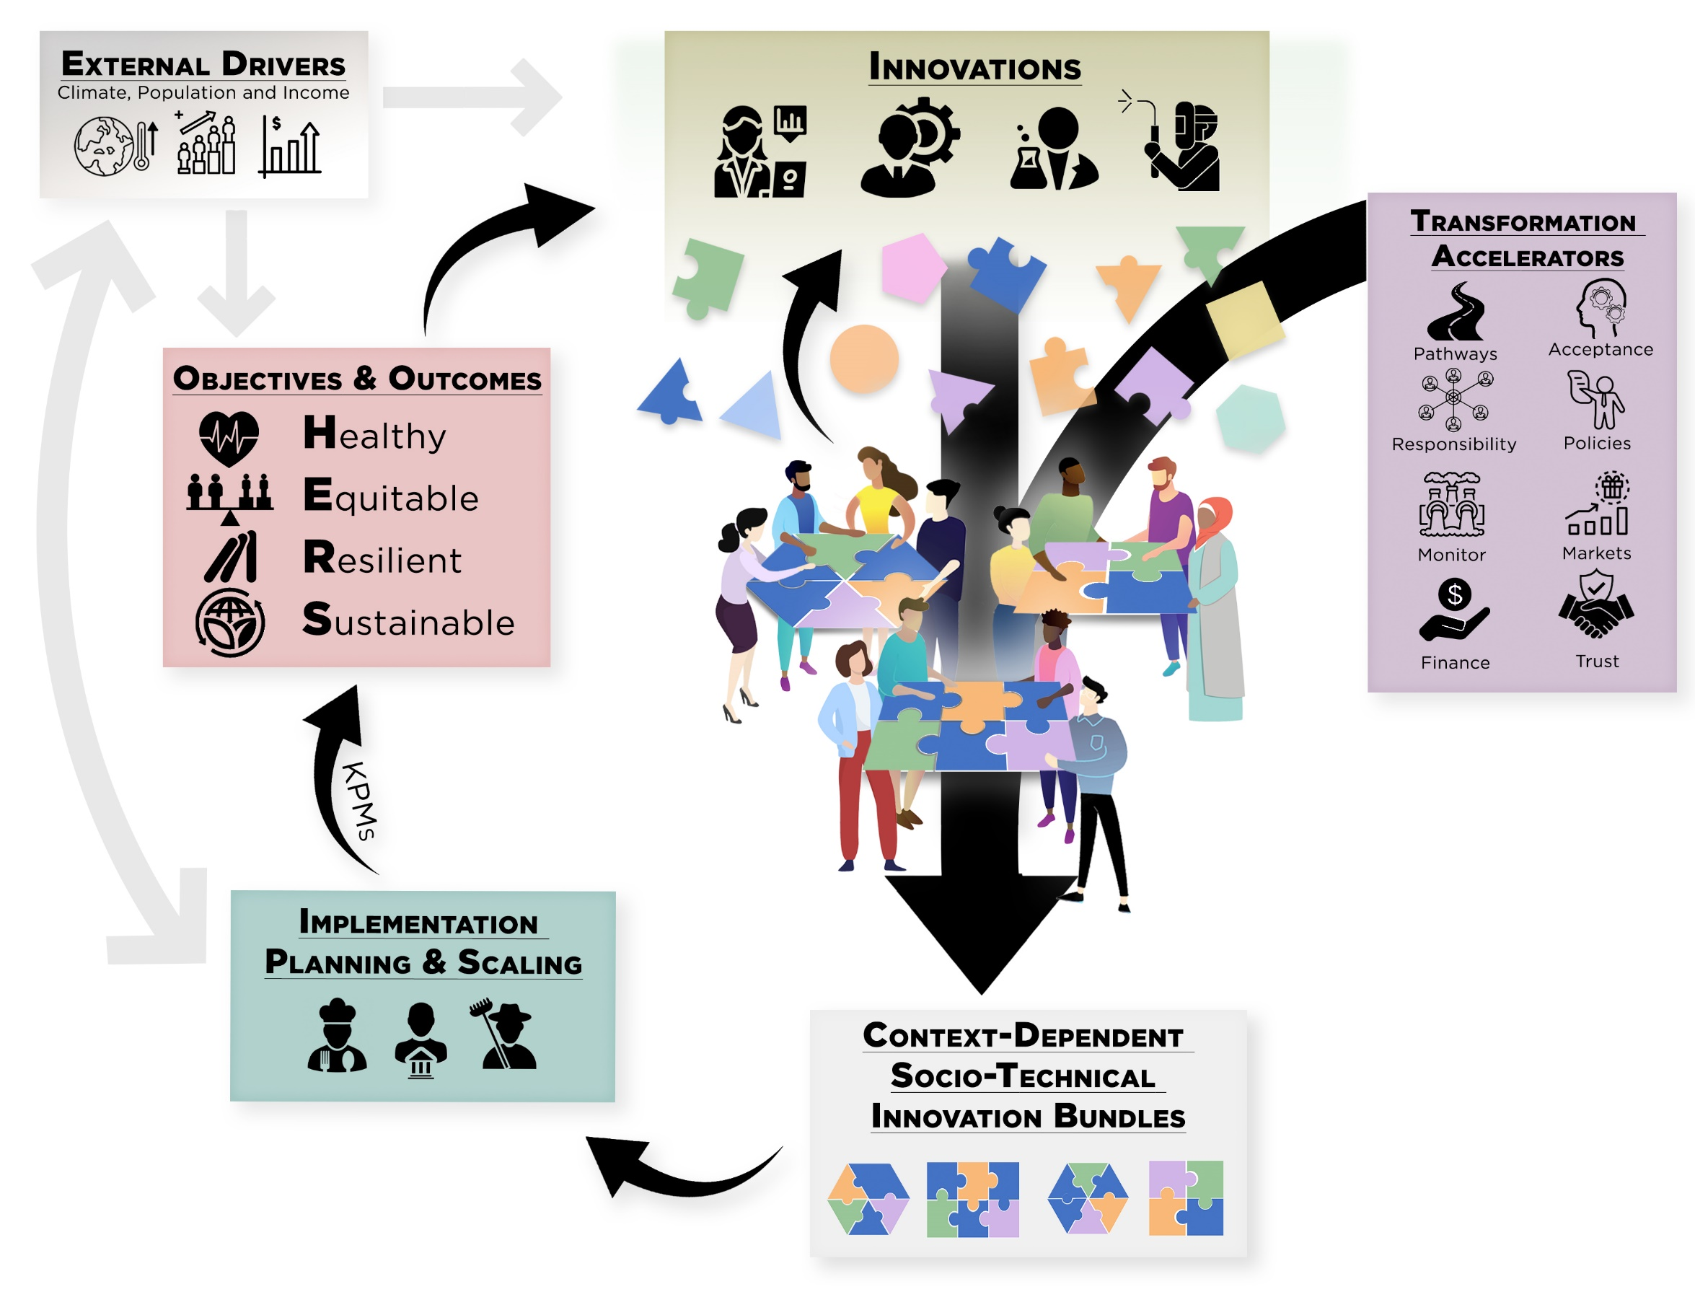
Must update objectives
The challenges ahead differ from those 50-90 yrs ago. Innovation objectives, strategies, metrics must too.
We must embrace/advance multiple objectives simultaneously
Build around a shared vision of HERS agri-food systems
Progress requires bundled soci-technical innovations

Slide 10
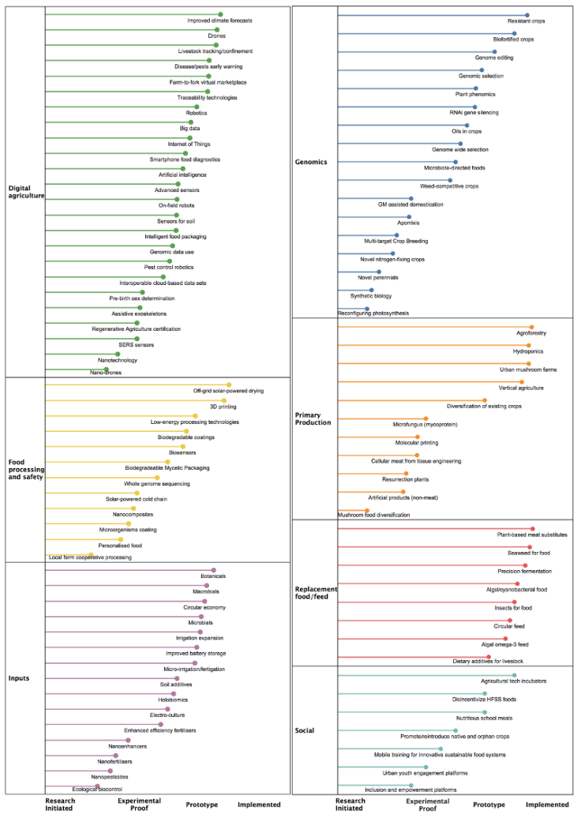
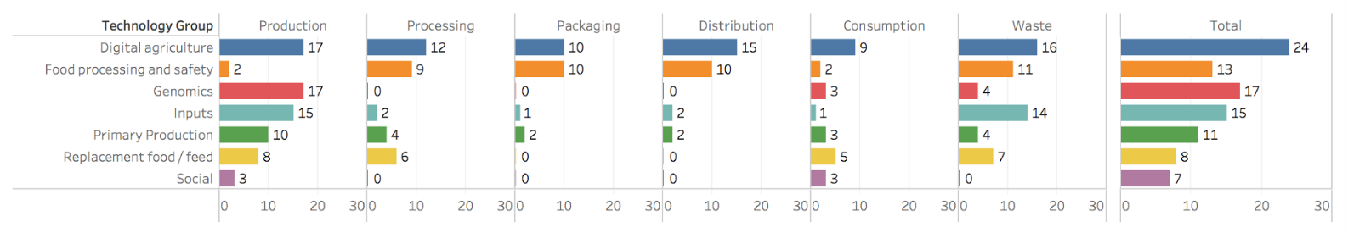
Ample STI in pipeline
Many promising pre-emergent/emergent STI advances of variable deployment readiness.
Span value chains and geographies.

Slide 11
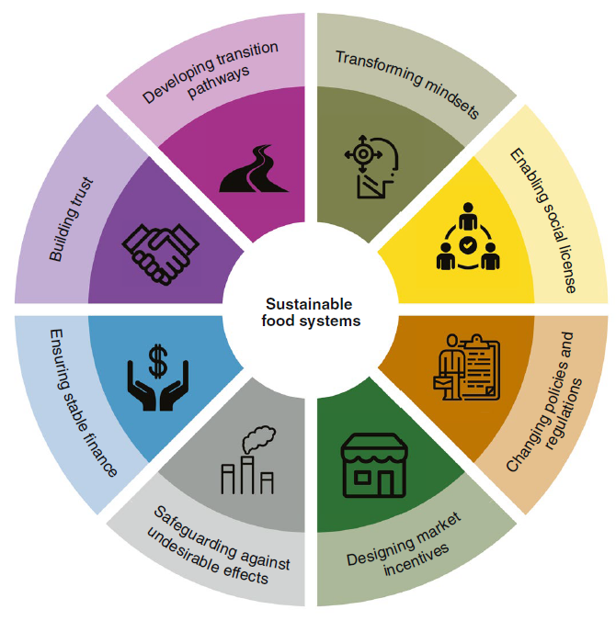
Improve R&D
But must address obstacles that make AFS R&D increasingly difficult, costly and mistargeted.
35% of >$52bn in 2021 agrifood tech VC funding was e-grocery! Adjust incentives to make solving societal problems financially attractive: advance market commitments, benevolent patent extensions, etc.
Address policy/regulatory obstacles: IP thickets, weak anti-trust enforcement, anti-science movements, etc.
Cautionary tale of Golden Rice vs. earlier generations of IR8/64.
R&D w/o policy/social change underdelivers
(Herrero et al. Nature Food 2020)

Slide 12
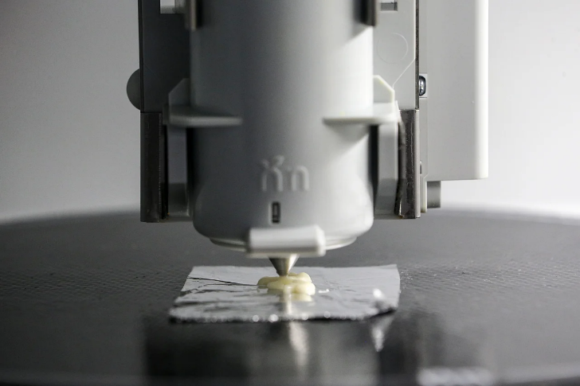
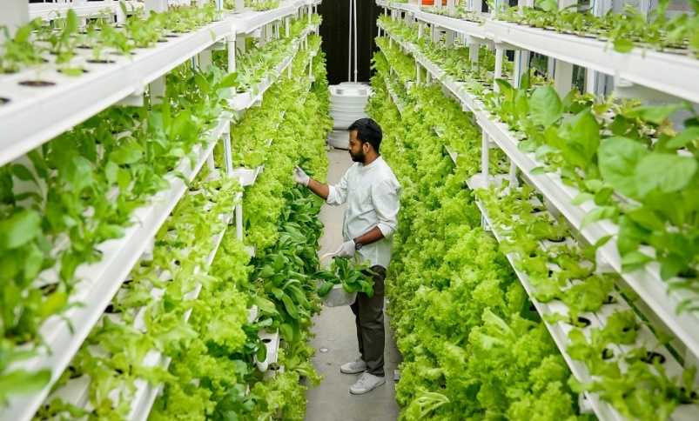
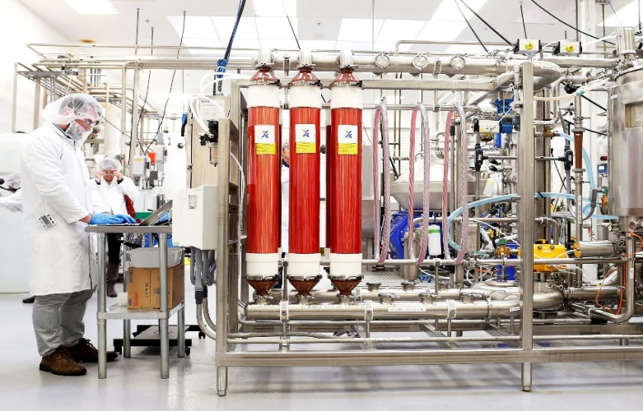
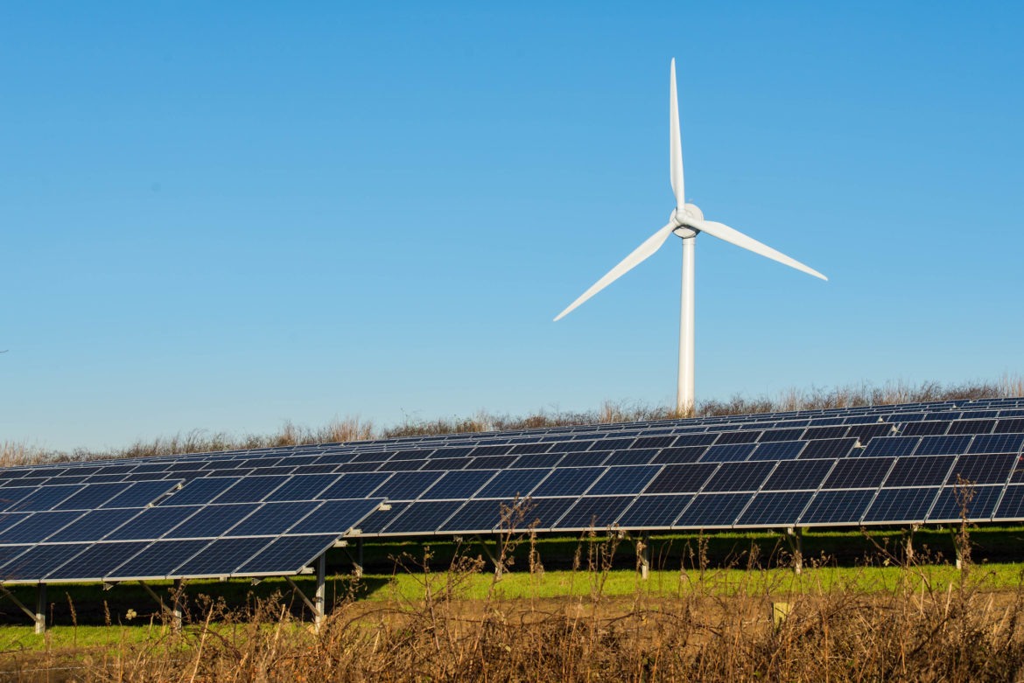
Proactive de-agrarianization
Decoupling food production from land is increasingly culturally, economically, technologically feasible. Crucial for climate and infectious disease control.
Photo: Wallace Woon (Straits Times)
Photo: Betterindia.com
Photo: Beck Deifenbach/Reuters
But must manage de-agrarianization’s
creative destruction proactively. Build
new rural livelihood opportunities.
Photo: Gerry Machen/Creative Commons

Slide 13
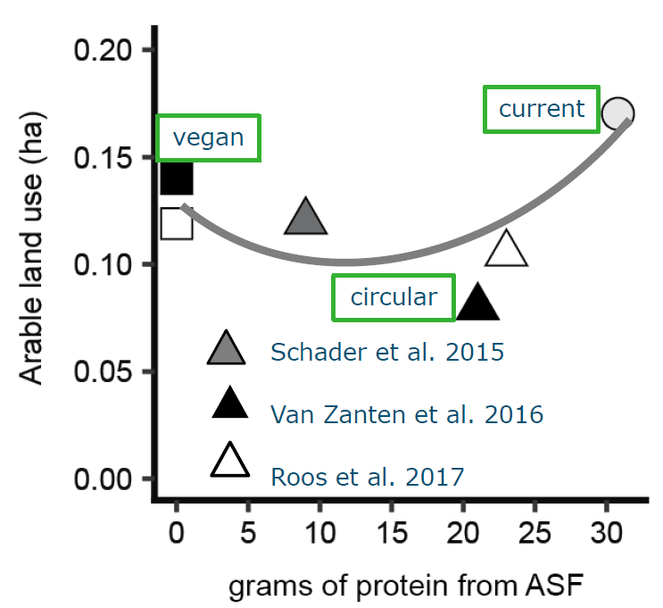
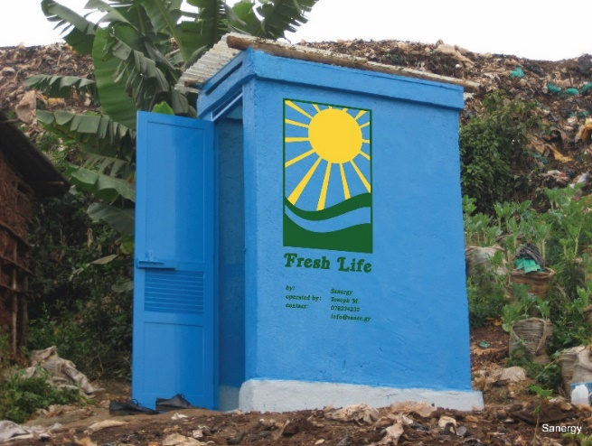
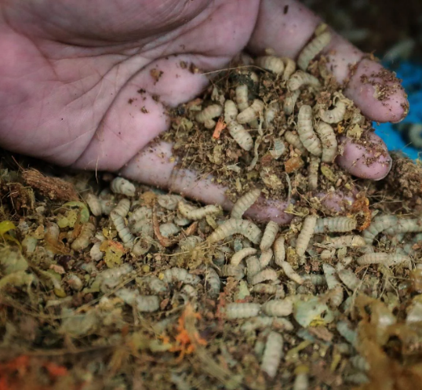
Circularity
Need cheap food for the poor.
But cheap food inevitably induces loss and waste.
Recapture the nutrients as feed and fertilizer to help deagrarianize!
Credits: Sanergy; Andrew Simons et al.; Jason Quah, Straits Times; H. Van Zanten
Can maintain 2/3 ASF consumption w/o food-feed competition.
Reduce cost and geopolitical/mkt vulnerability to NPK supply disruption.

Slide 14
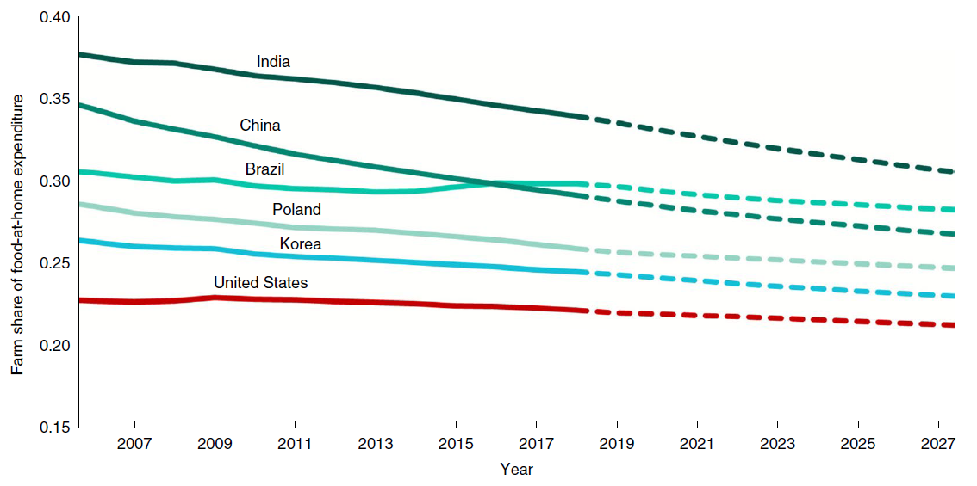
Beyond farmers and chefs
Most AFS jobs, ultra-processing/fortification, and value creation (~3/4 globally!) occur post-farmgate. Big environmental impacts, too. Businesses drive AFS!
Source: Barrett et al., JEL in press
Source: Yi et al., Nature Food 2021
Consumer non-nutritive food attribute demands increasingly drive upstream production patterns. True cost pricing opportunities exist.
Credence attributes: trust increasingly important, in science, in info, in service providers (regulation, standards, traceability, labeling ever more important)

Slide 15

Must consciously bundle
Why socio-technical innovation bundles?
  No magic bullets exist. Multiple constraints in play at once. Relaxing just one limits progress. Must realize synergies to adapt/scale.
  Example: IR8/64 vs. Golden Rice.
Photo credit: IRRI

Slide 16
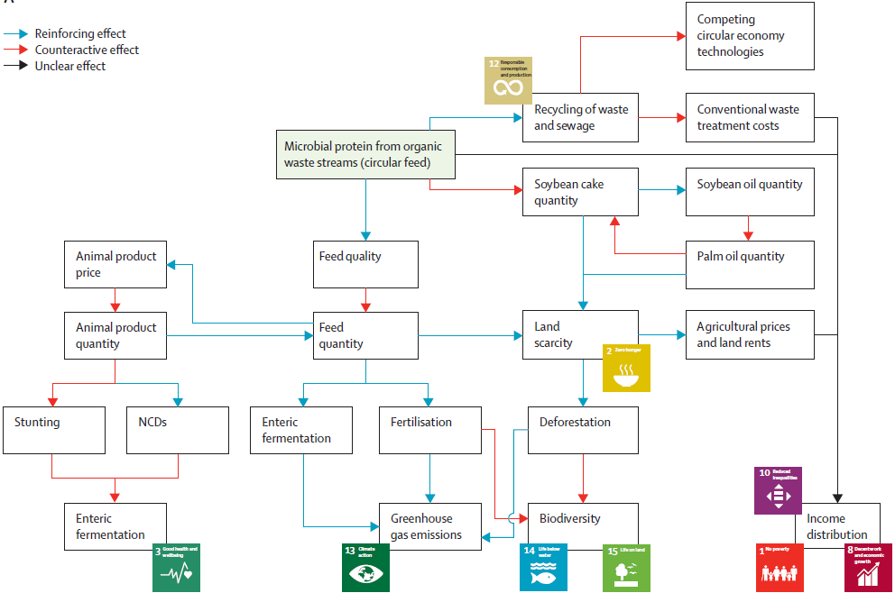
Must consciously bundle
Why socio-technical innovation bundles?
  (2) Must address predicted but unintended consequences. This generates a political economy of opposition due to spillovers and creative destruction. Bundling can build coalitions to overcome incumbent status quo bias.
  Also helps promote cooperation and peace.
Source: Herrero et al. Lancet Planetary Health 2021

Slide 17
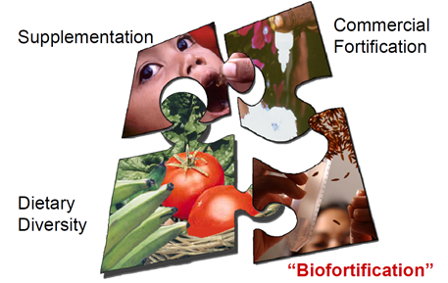
Must consciously bundle
Why socio-technical innovation bundles?
  (3) Heterogeneous needs require bundled solutions
Graphic credit: Ross Welch/Mike Gore
Graphic credit: Ross Welch/Mike Gore

Slide 18

Why should we care?
Food security is a human right (Art. 25 1948 UDHR), intrinsic to human flourishing
Food security exists if and only if
“all people at all times have physical, social, and economic access to sufficient, safe and nutritious food that meets their dietary needs and food preferences for an active and healthy life”
(1996 World Food Summit definition, emphasis added)

Slide 19

Why should we care?
And basic security depends on food security

Slide 20
Don’t despair, but don’t dally
We face formidable challenges but they are manageable
We face a food crisis but have prevailed before in food crises and can/will again
Requires:
progressive strategy – trust science and support the poor
focus on a small set of HERS objectives and build coalitions
Incentivize and bundling innovations from varied domains
Thank you for your time and interest!

